Slide 1
Effective data visualizations
Dr. Carlos Ramirez
University Libraries
Research Data Services

Slide 2
Purpose
Participants will be able to:
Use design principles while creating visualizations
Interpret data visualizations critically
Assess effective data visualizations
Application:
Improve participants’ presentations, reports, articles

Slide 3
Agenda
What are data visualizations?
Why we make data visualizations?
Best practices – Design principles
Practice: The Good, The Bad & The Ugly of viz
Story telling with data visualizations
Resources

Slide 4

Data visualization
Graphical representation of information and data

Slide 5

Why do we make data visualizations?
We make data visualizations to convey a lot of information at once
We are visual learners!

Slide 6
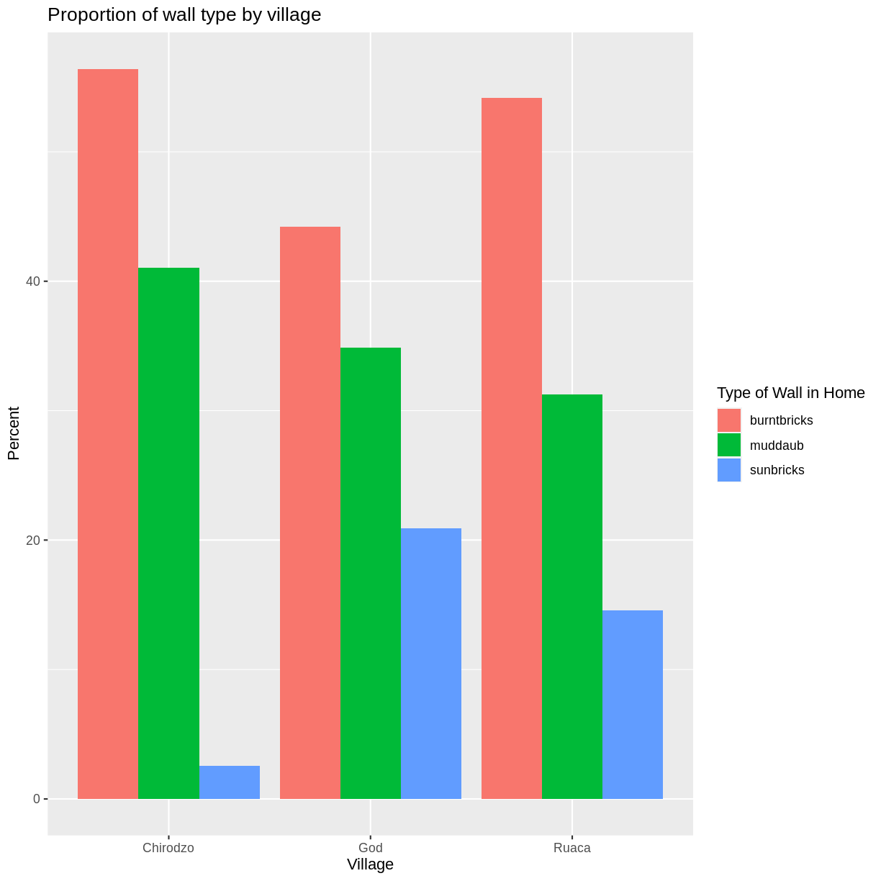
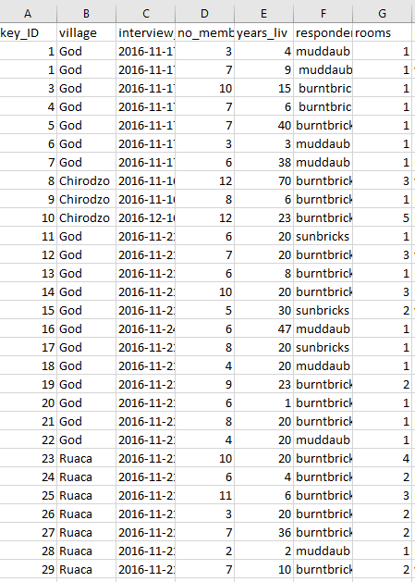
Why do we make data visualizations?
We make data visualizations to convey a lot of information
We are visual learners!

Slide 7
We are visual learners!

Slide 8
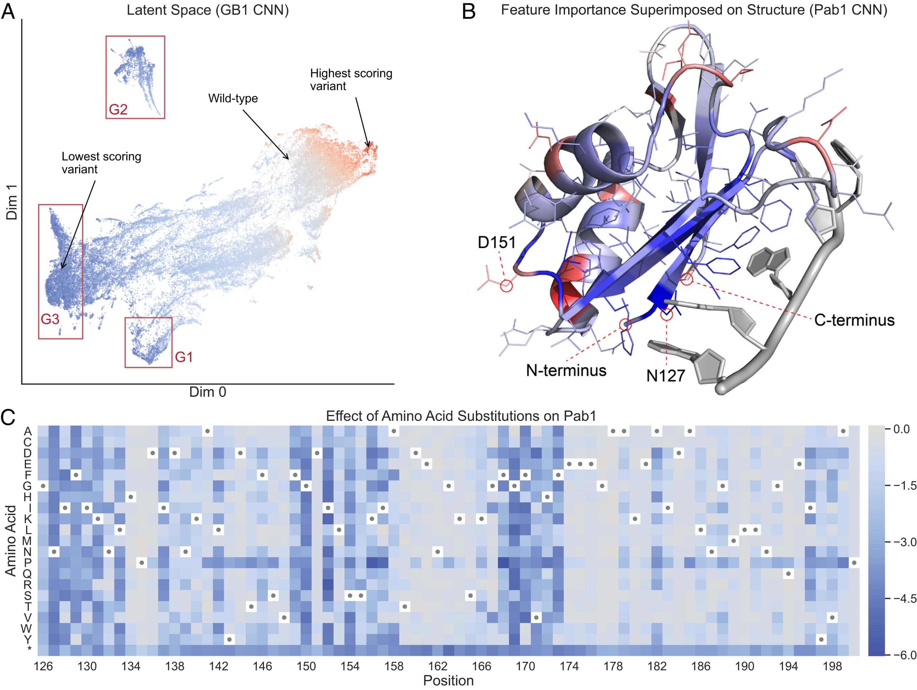
Why is data visualization important?
Improve communication
We want to help our audience to digest data
Raise value to our work
Take home messages are easy to identify
Describe the invisible
We measure imperceptible things: molecules, radiation, perceptions
Gelman et al. 2021

Slide 9
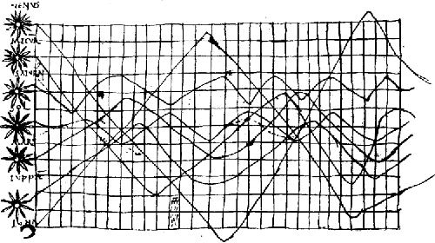
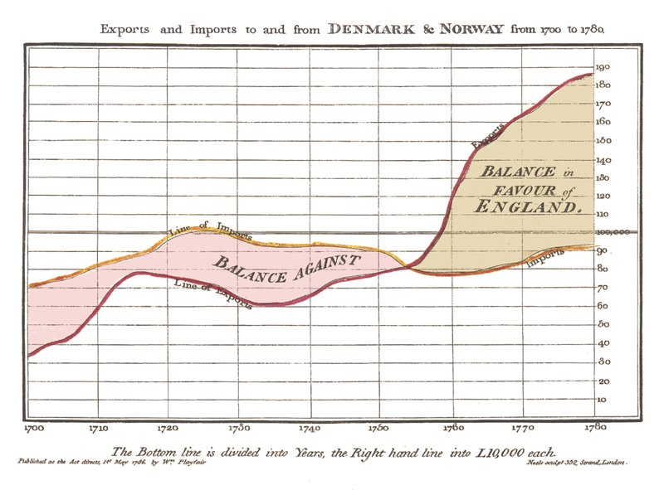
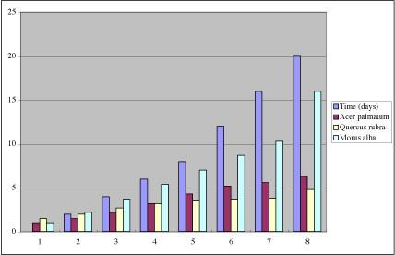
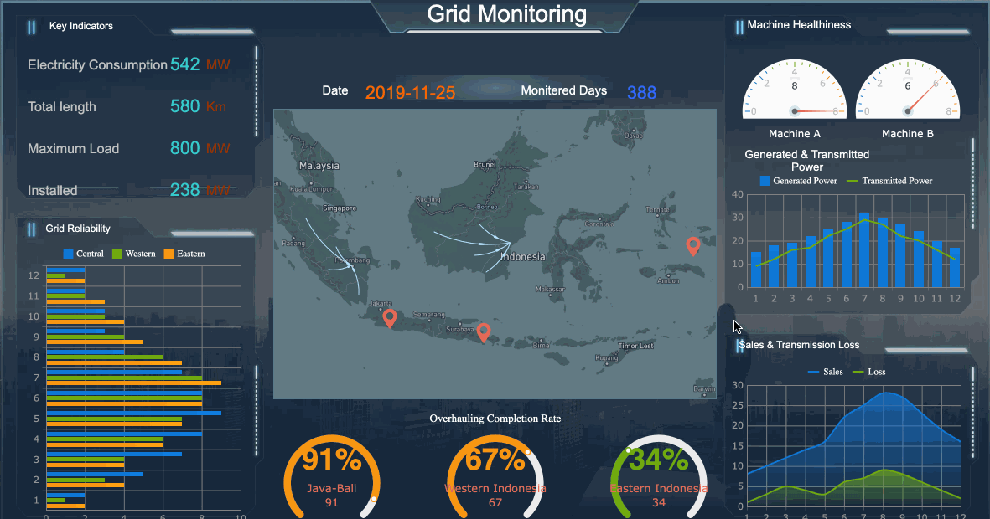
Data visualizations over time
X century
XVIII century
XX century
XXI century
FineReport

Slide 10
What happens with bad visualizations?

Slide 11
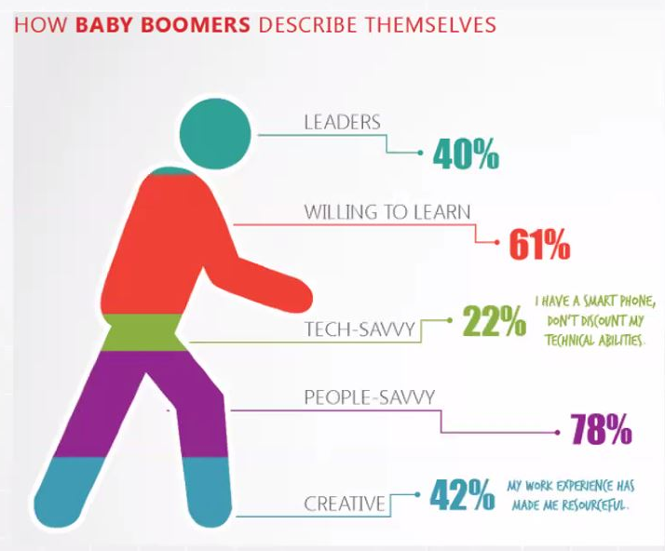
Poor viz design makes information lie

Slide 12
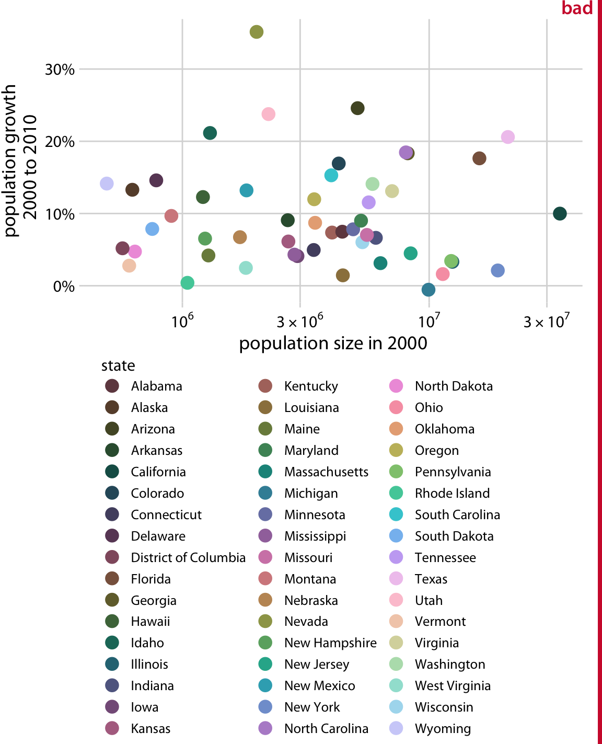
Poor viz design makes information invisible

Slide 13
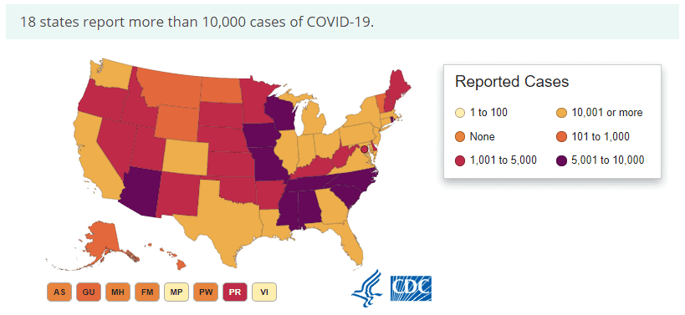
Poor viz design leads to misleading information

Slide 14
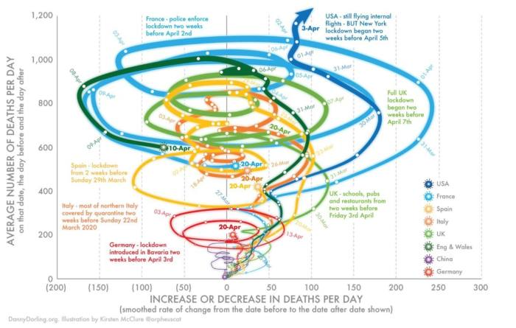
Poor viz design makes information confusing

Slide 15
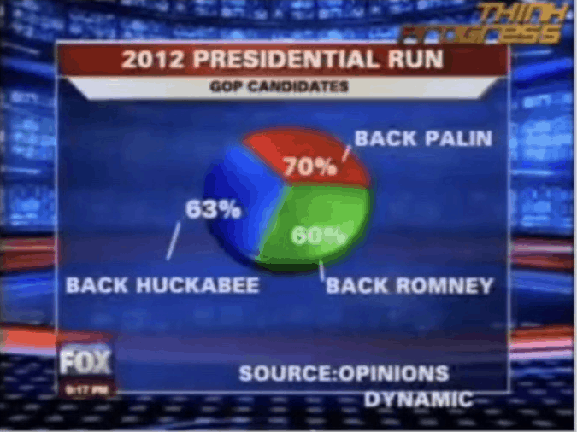
Poor viz design makes us loose credibility

Slide 16
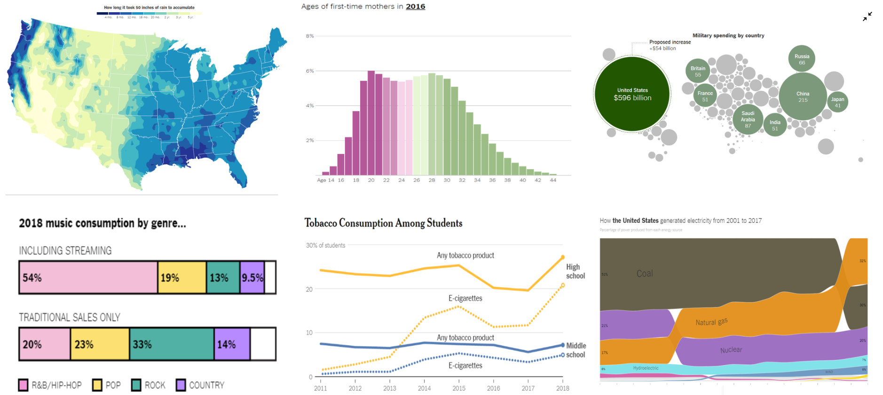
Best practices for Data Viz – Design principles
Adobe

Slide 17
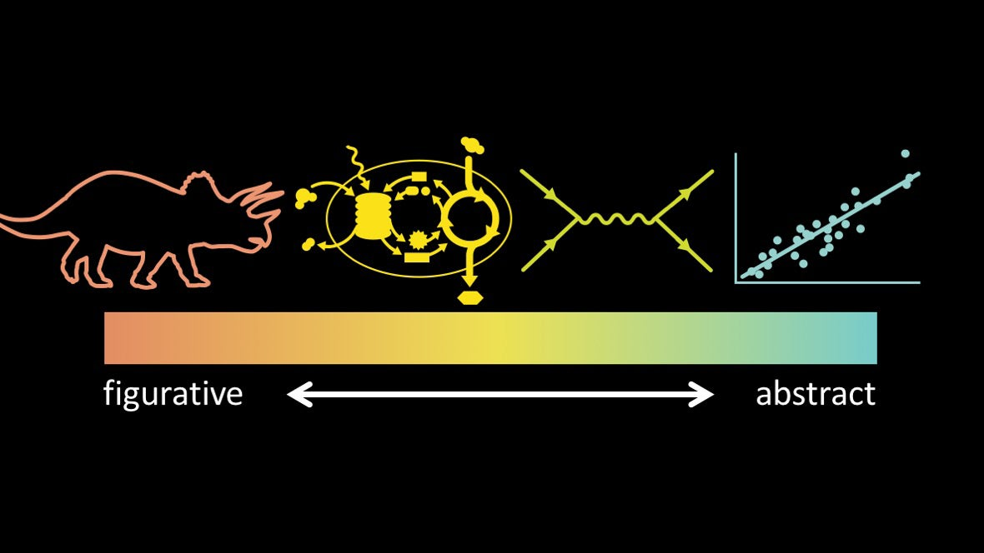
Information graphics
Jen Christiansen

Slide 18
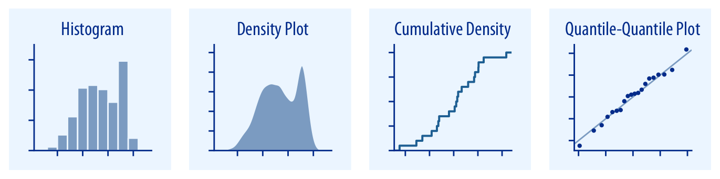
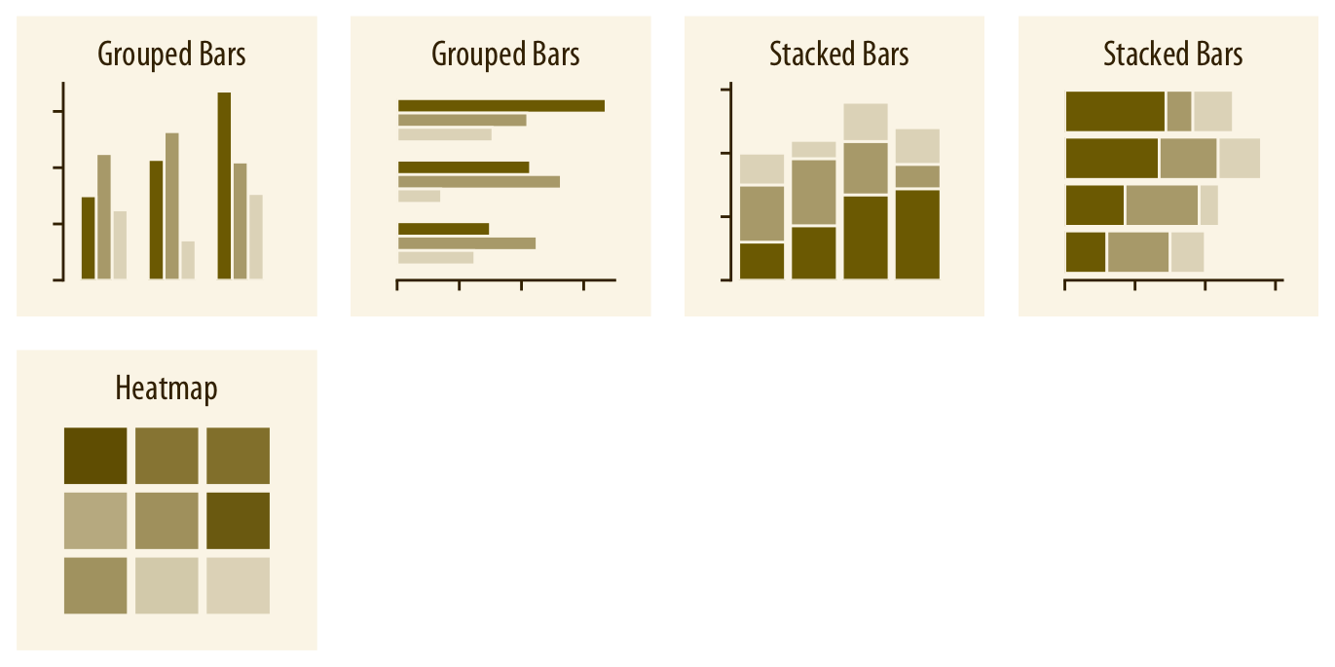
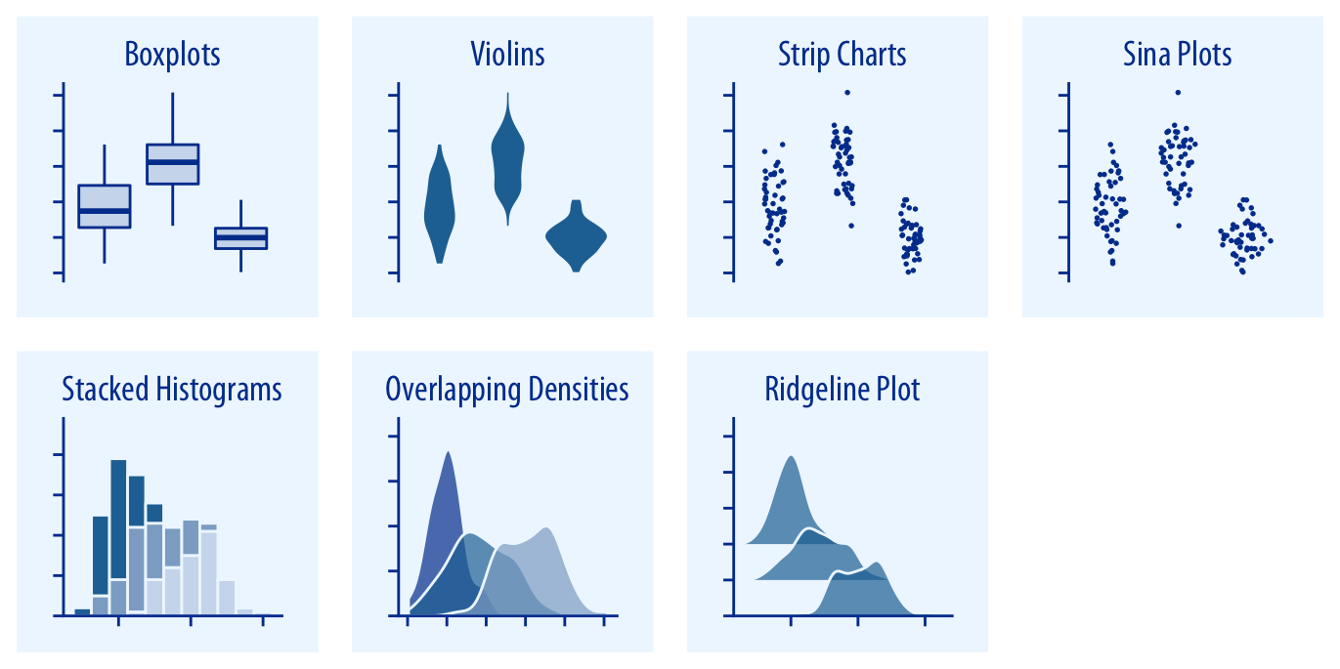
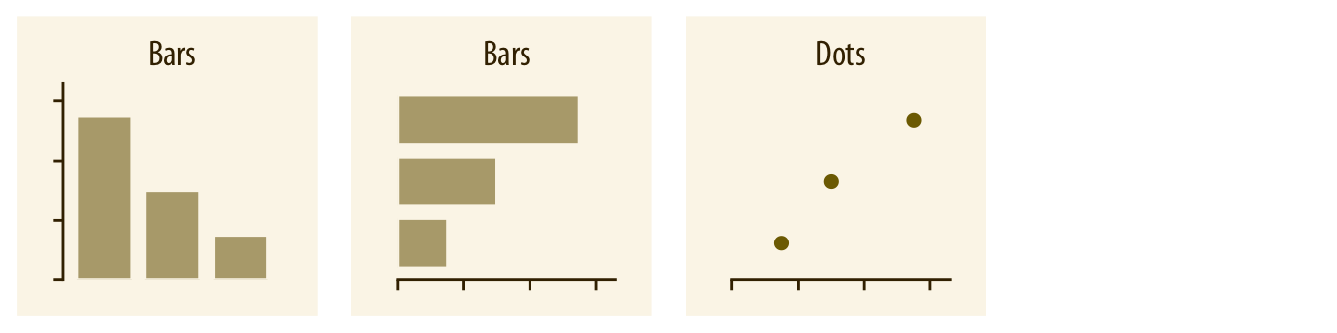
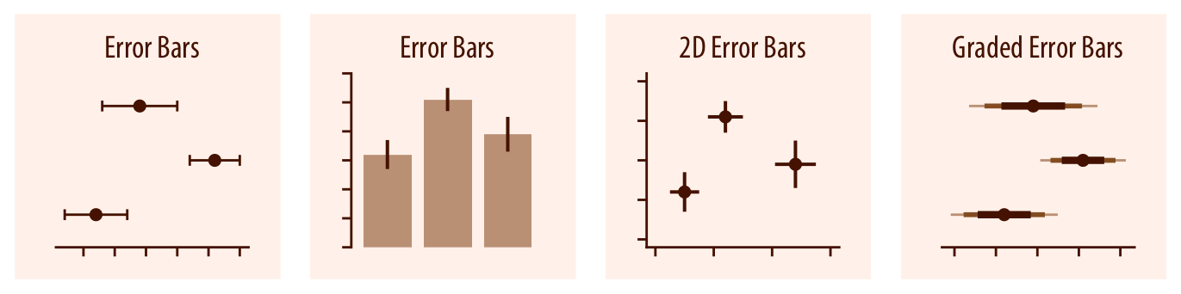
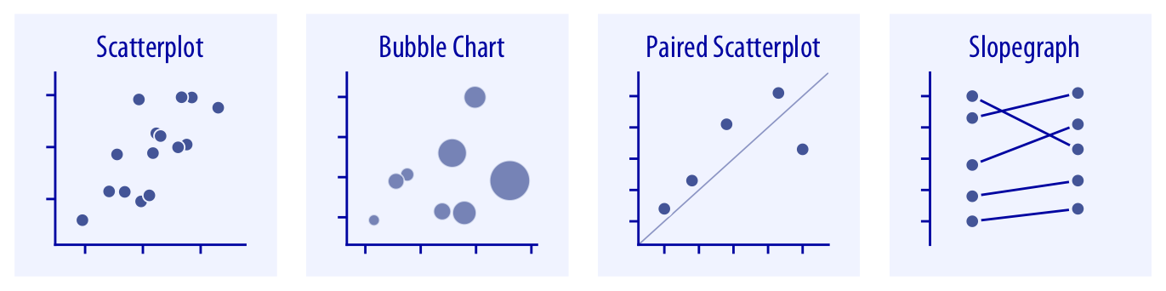
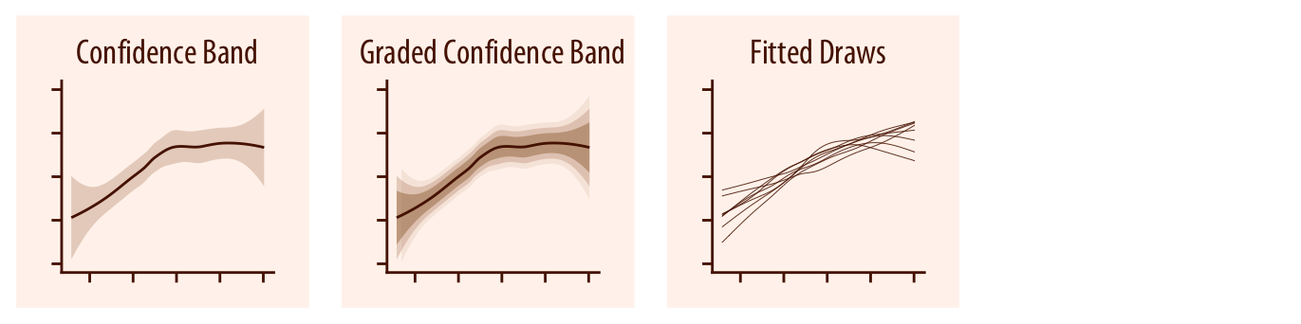
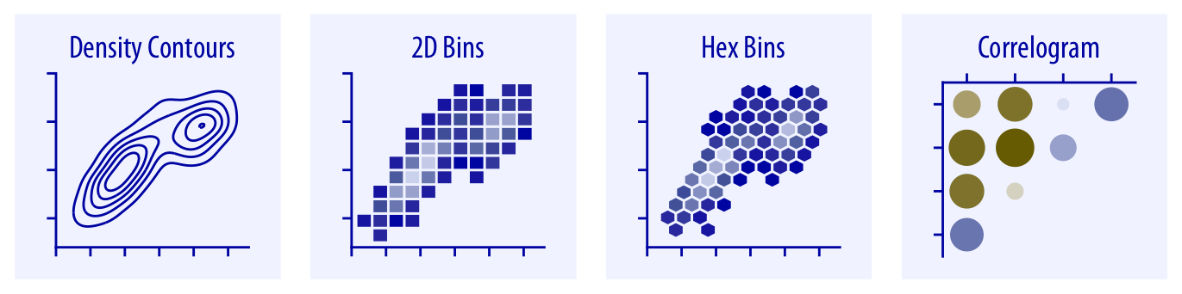
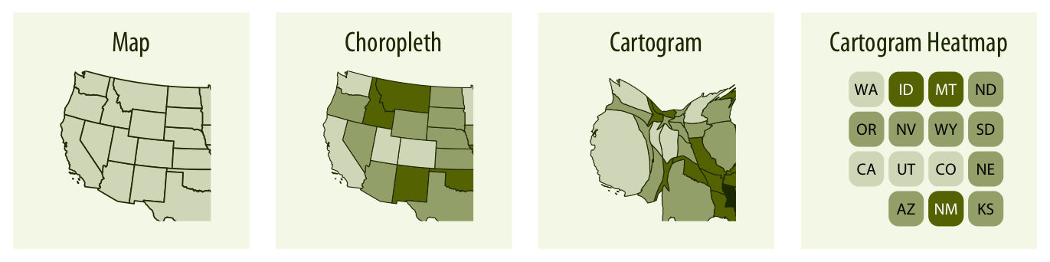
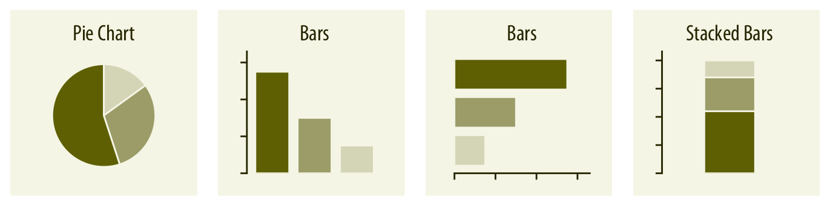
Directory of visualizations
Distributions
Amounts
Uncertainty
x- y
relationships
Geospatial data
Proportions
Wilke

Slide 19
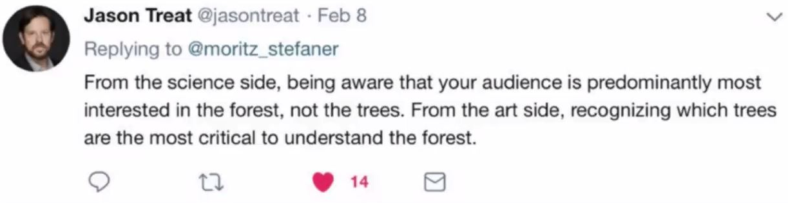
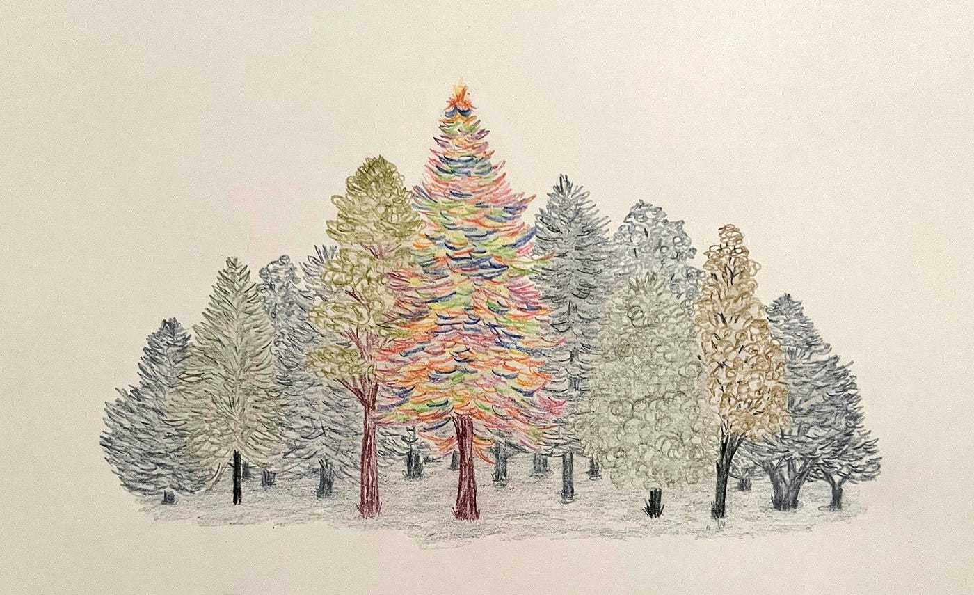
Data visualization is meant to assist learning
Science communication tools
While not art, it can borrow design principles

Slide 20

Some design principles
Know your audience
Minimize cognitive load
Build on pre-existing associations
Fewer colors and use them constantly
High contrast for accessibility
Gestalt principles of visual perception

Slide 21



Know your audience

Slide 22
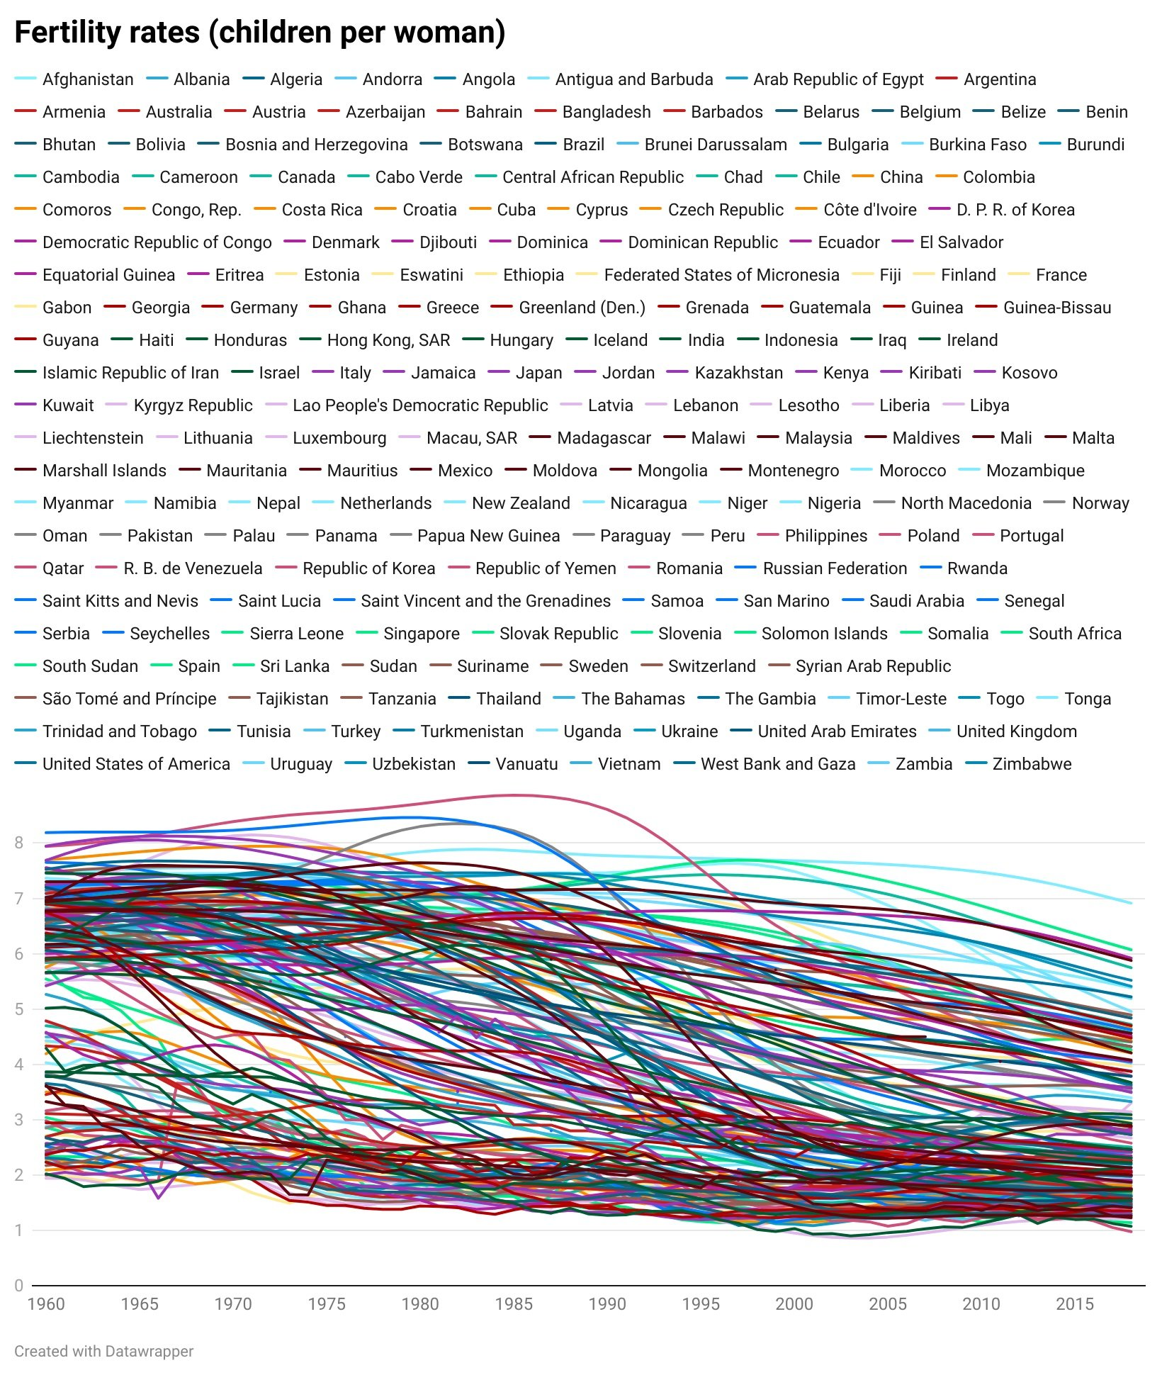
Minimize cognitive load

Slide 23
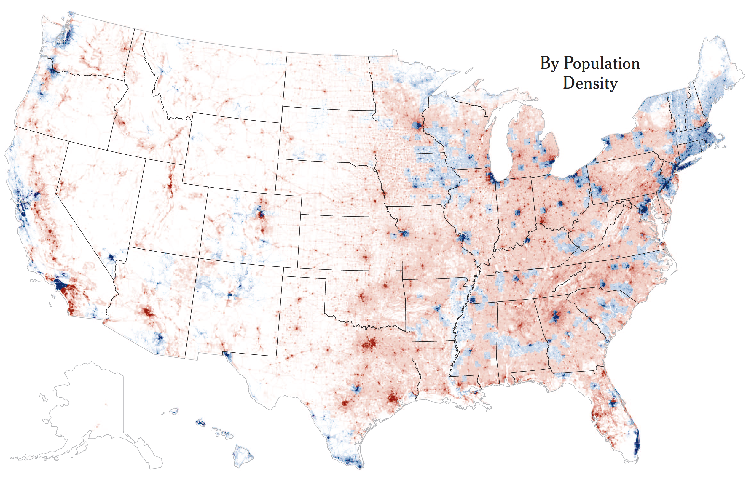
Build on preexisting associations
Map Election Results
nytimes.com

Slide 24
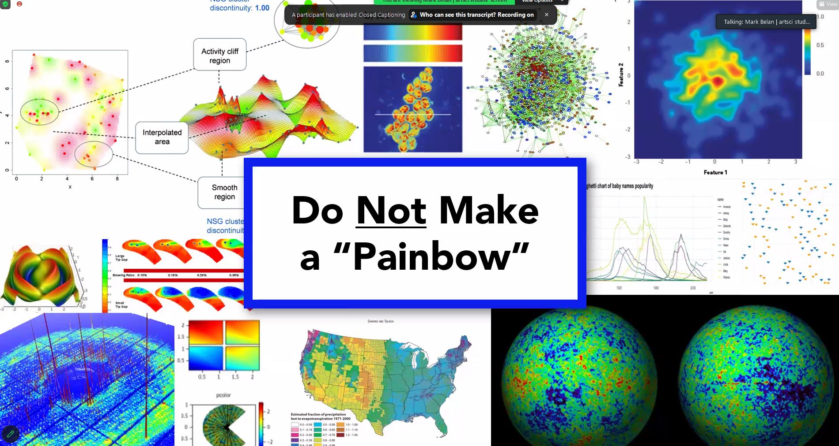
Fewer colors and use them constantly

Slide 25
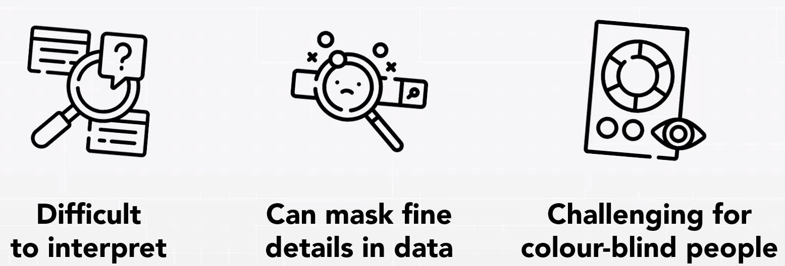
Use fewer colors and use them constantly

Slide 26
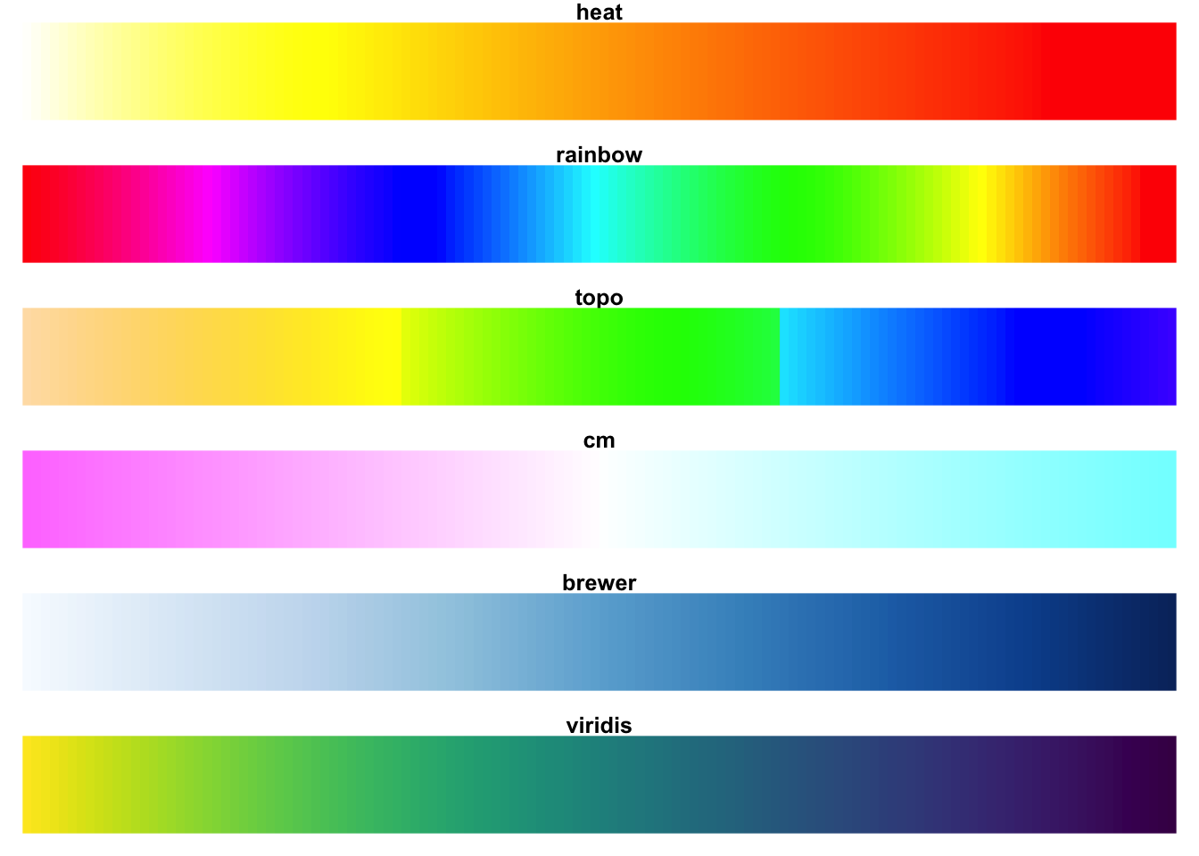
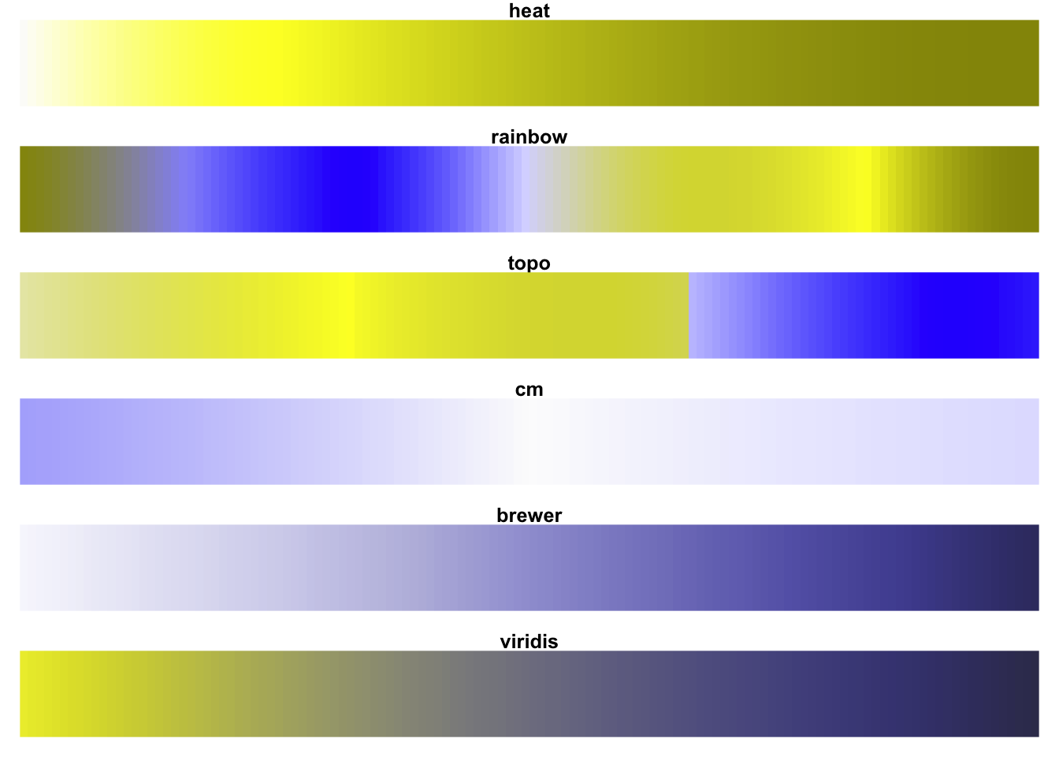
Fewer colors and use them constantly
“Normal” Vision
Green-Blind (Deuteranopia)
Ensure a continuous increase in perceived intensity

Slide 27
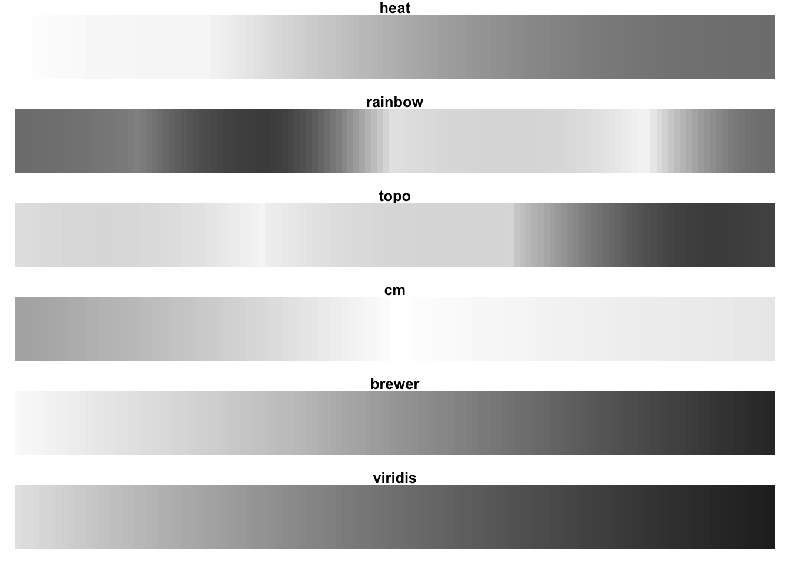
Fewer colors and use them constantly
“Normal” Vision
Desaturated

Slide 28
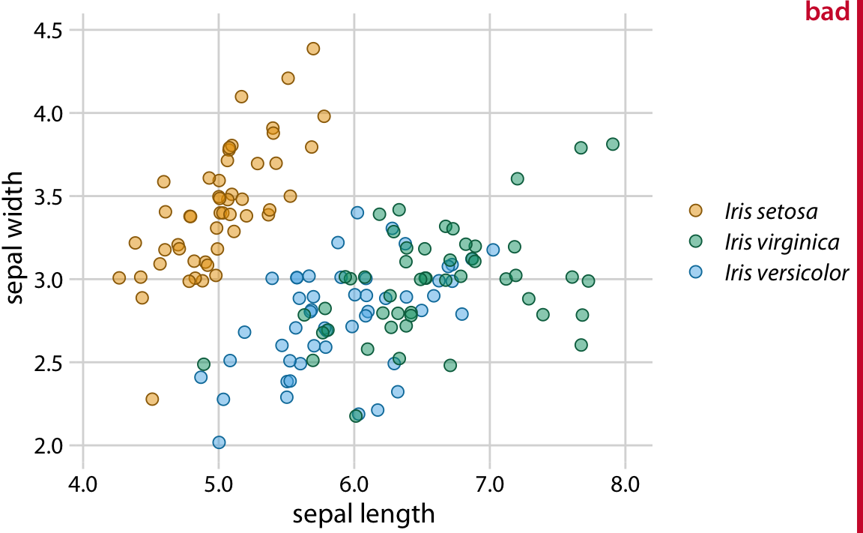
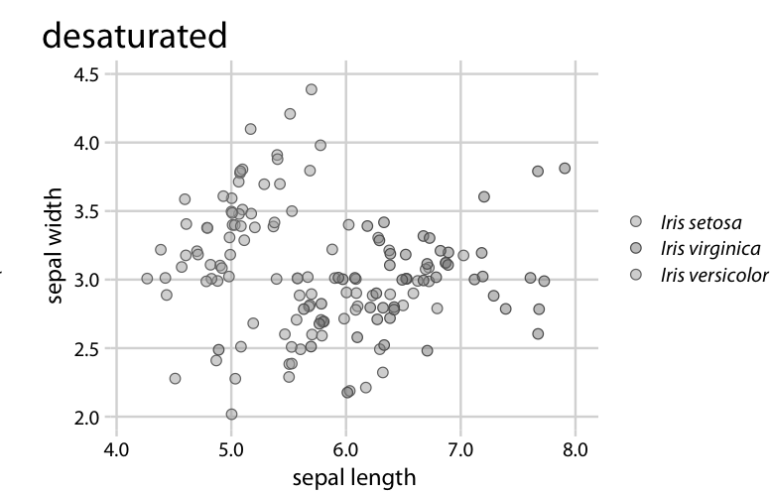
Higher contrast for accessibility

Slide 29
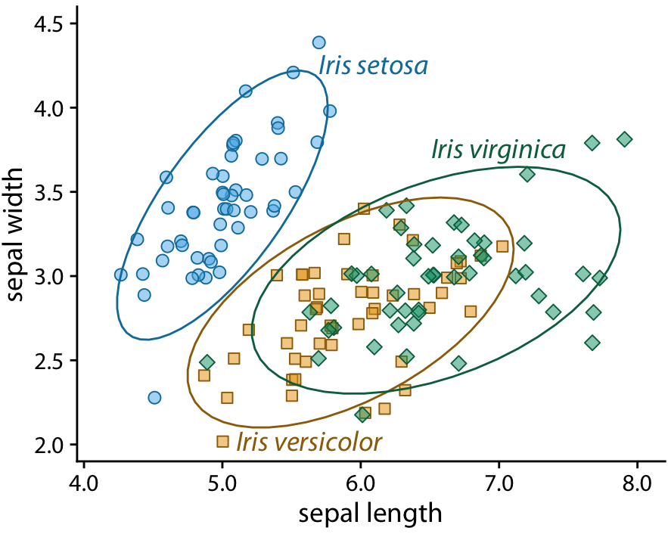
Higher contrast for accessibility

Slide 30
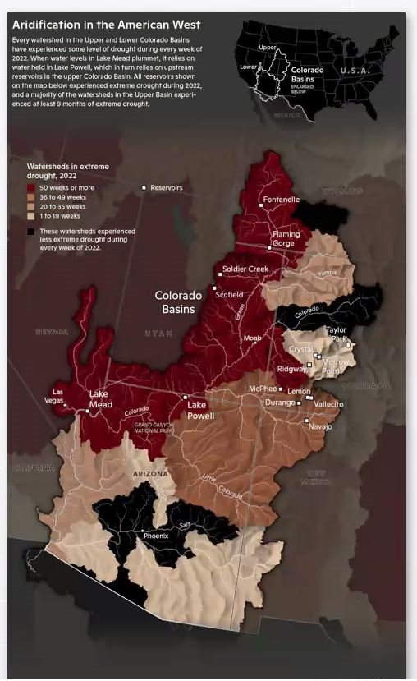
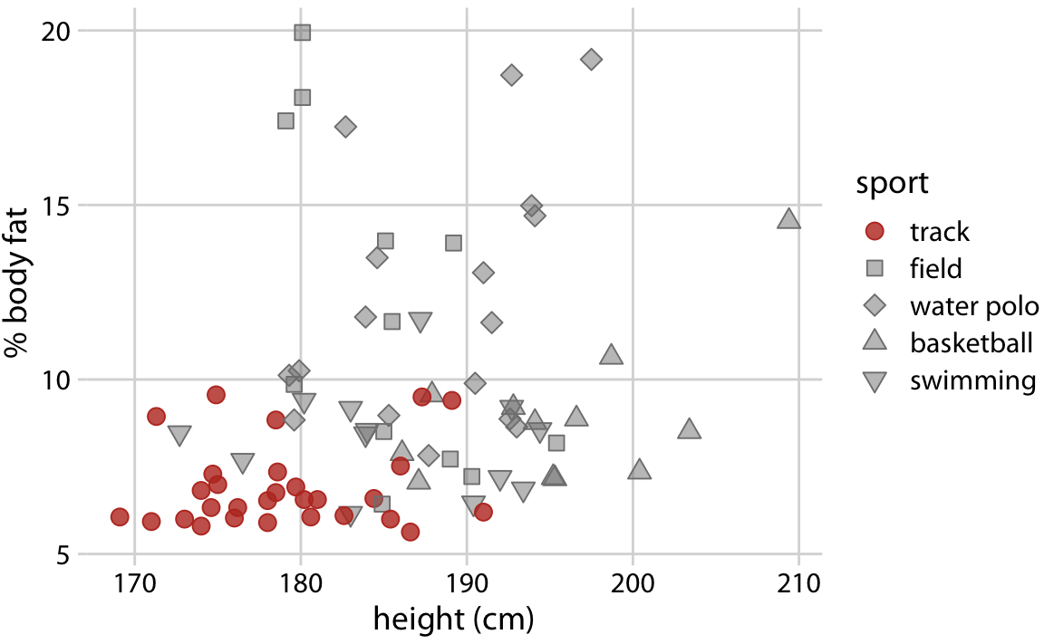
Color as a tool to highlight (salience)

Slide 31
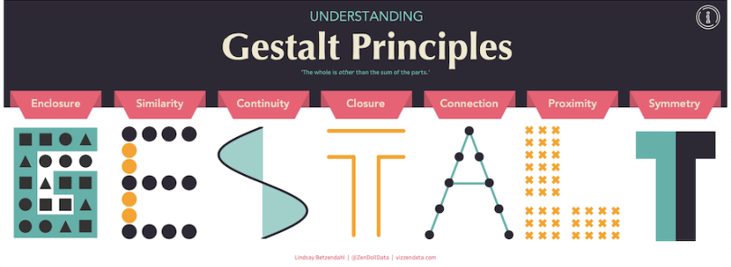
The Gestalt Principles describe how the human brain sees visual information

Slide 32
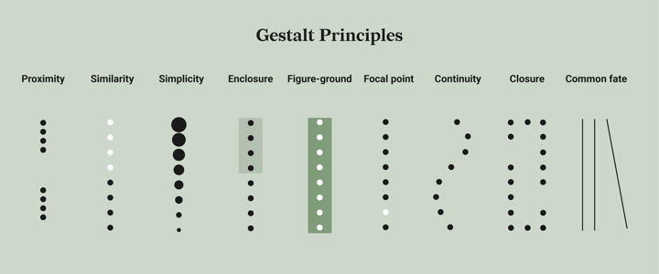
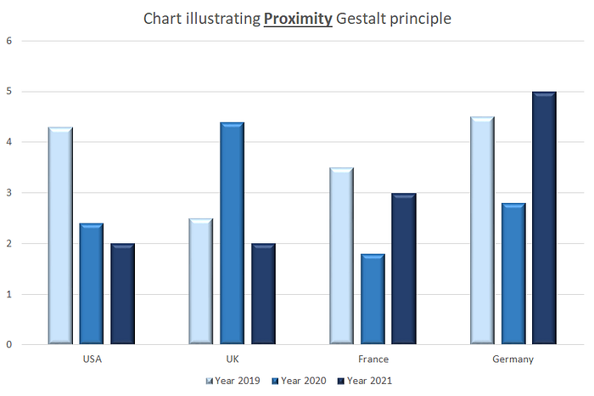

Slide 35
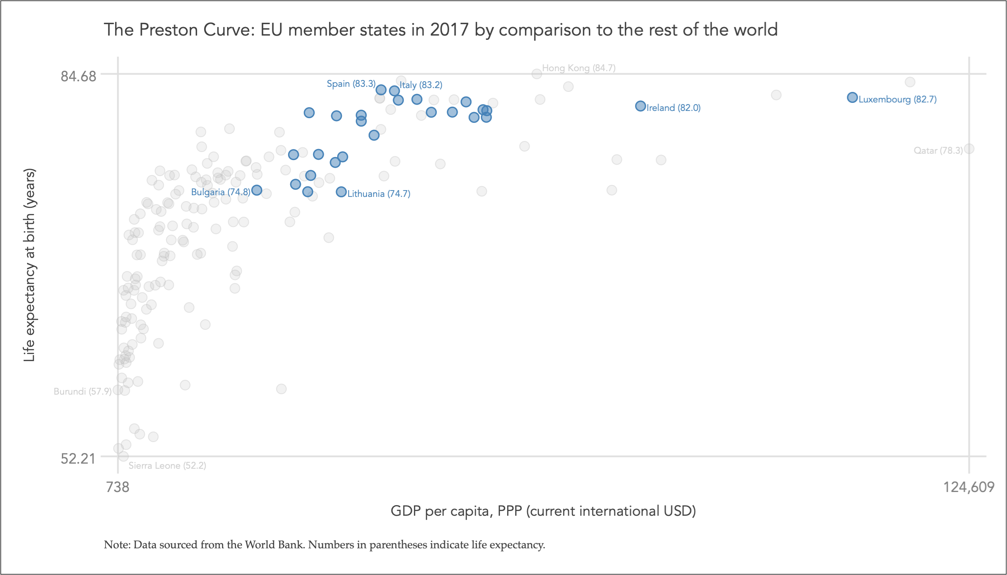

Slide 36
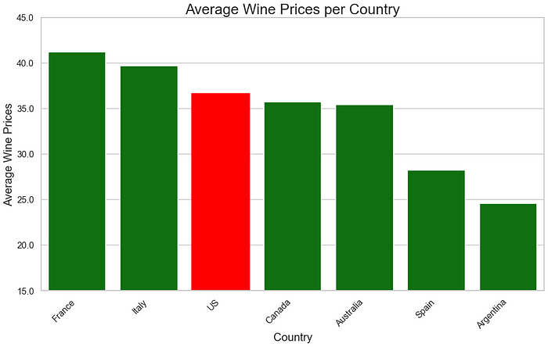

Slide 37
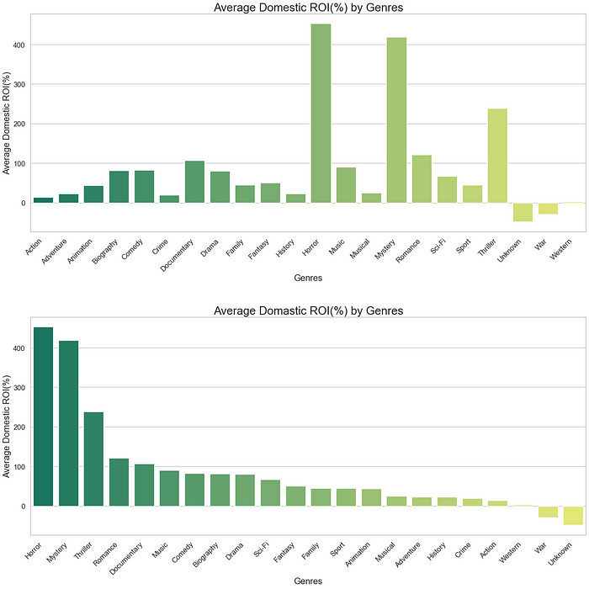

Slide 38
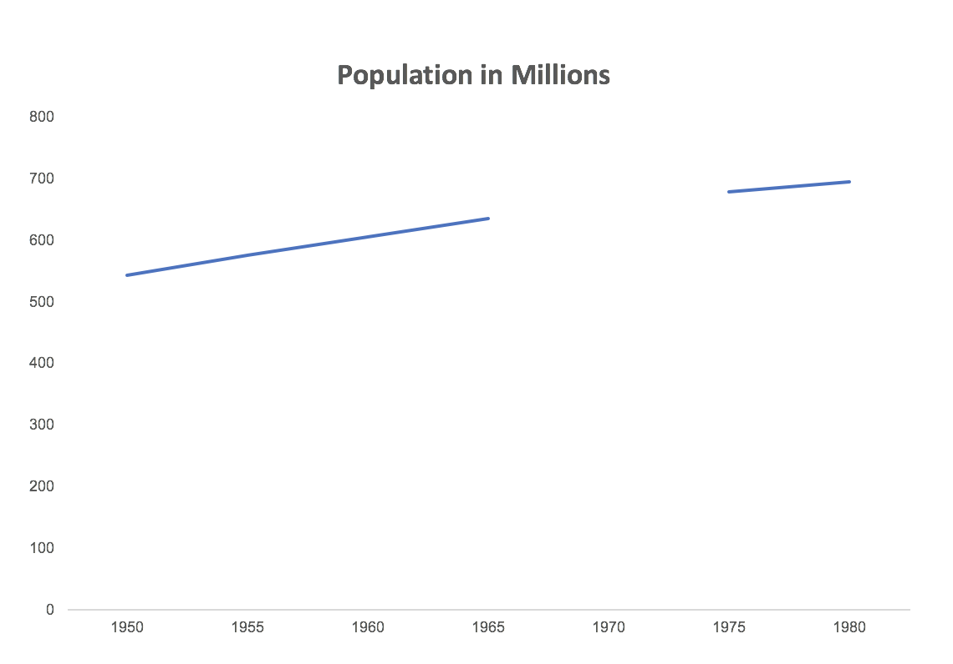

Slide 39
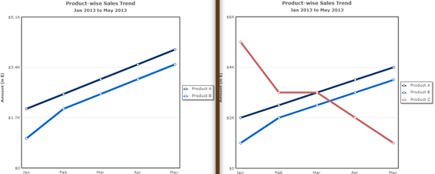

Slide 40
Other suggestions:

Slide 41
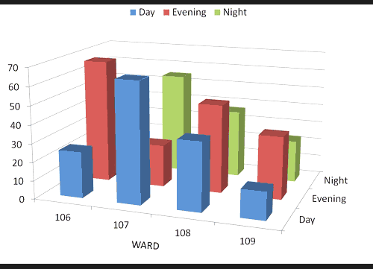
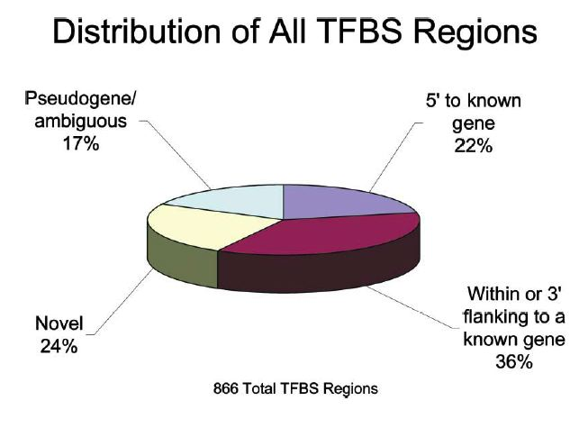
Avoid 3d graphs

Slide 42
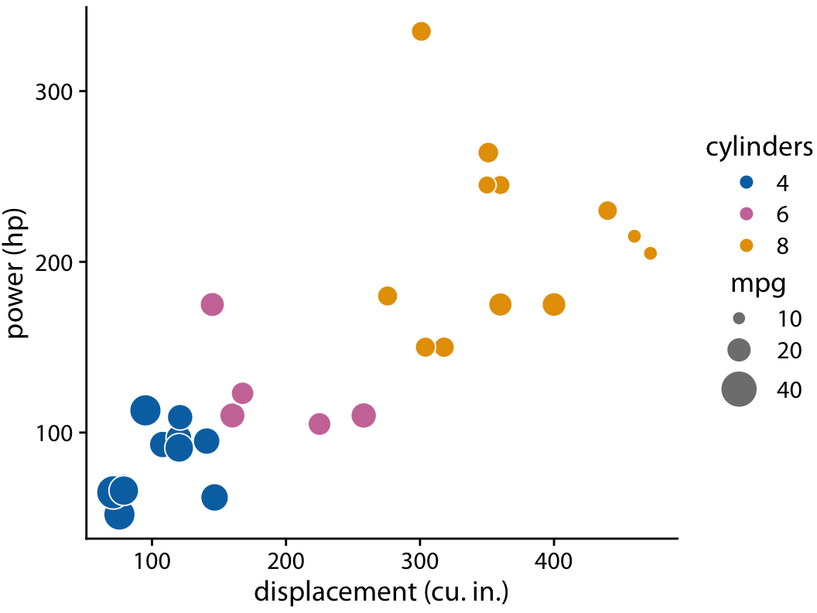
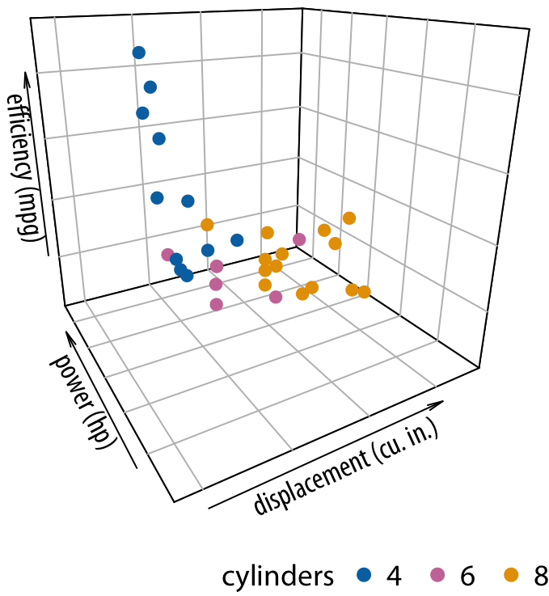
Avoid 3d graphs
Alternative:

Slide 43


Slide 44

junkcharts

Slide 45

Additional tips
Not because you did a lot work, you need to visualize everything!
It is ok to drop data, choose wisely and honestly
Think on the journal page costs
Do I need this viz?
Can I make it smaller?
During publishing review process you’ll likely re do your figures
Do them reproducible (e.g., R or Python)
Like any work, a good figure is a finished one!
Don’t fall into rabbit holes!

Slide 46
Let’s practice by evaluating some visualizations

Slide 47


Slide 48

PRISM3 - Scatter Plot of Mean Annual SST Anomalies by Latitude
Florence Bascom Geoscience Center

Slide 49


Slide 50


Slide 51


Slide 52


Slide 53


Slide 54
The good, the bad, and the ugly of visualizations (Bad, ugly, good)

Slide 55




Slide 56


Get to the point of your message

Slide 57


It is a bad practice to make your readers guess what you mean

Slide 58


Consistency is key

Slide 59


Slide 60
Better formatting

Slide 61


Slide 62
Avoid pie charts!

Slide 63


Slide 64


Avoid pie charts!

Slide 65


Slide 66
Mistake: Truncating the scale

Slide 67


Slide 68
Mistake: Forcing a relationship by cherry-picking scales

Slide 69


Slide 70
Mistake: Charts that conceal their point

Slide 71
Take a step further: Make a story graph!

Slide 72


Take a step further: Make a story graph
Goal: Visualize mean temperature across Nevada counties

Slide 73



Slide 74



Slide 75


Slide 76



Slide 77


Slide 79
Take home messages
Less is more
Data visualization can be misleading
Apply design principles
Focus on the message you want to convey: What is your data saying? Then visualize that message
Try to tell a story with your visualization

Slide 80
Resources for you

Slide 81

Resources for data visualization

Slide 82


Resources for data visualization
Excel
R
Python
PowerBI
Tableau

Slide 83


Slide 84



From Data to Viz

Slide 85



Slide 86


Get inspiration

Slide 87

UNR Libraries Research Data Services
Support in data:
Collection
Manipulation/wrangling
Analysis, Statistics
Visualization
Management, Archiving, Curation
Facilities:
DeLaMare library Data Works South 18 computers
GIS/ Remote sensing software (QGIS, ArcGIS, ArcPRO, Envi, GRASS)
Computing & Statistical (Matlab, SPSS, R, Python)
Consultations:
Appointment & Office hours
Ashley - Social Science Data, R, Statistics: Tue & Wed 2:30-4pm
Carlos - Remote sensing, GIS, R, Research Data: Tue & Thu 2-3pm
Chrissy – Geosciences data, GIS, Maps: Mon & Wed 3-5pm
Appointment only
Teresa – Data management, social science data
Elena - Data management, health science data, meta-analysis
Challen - Metadata
Google “UNR Data Services” or visit directly: https://library.unr.edu/places/delamare/research-data-services

Slide 88
References to graphics used:
https://scds.github.io/ds-bytes/ScienceCommunication.html
https://www.youtube.com/watch?v=jt-VdyFzjj0&ab_channel=NetworkoftheNationalLibraryofMedicine%5BNNLM%5D
https://library.ucsd.edu/about/contact-us/librarians-and-subject-specialists/stephanie-labou.html
https://www.toptal.com/designers/gui/principles-of-design-infographic#:~:text=There%20are%20twelve%20basic%20principles,that%20make%20sense%20to%20user
‘https://medium.economist.com/mistakes-weve-drawn-a-few-8cdd8a42d368
https://www.oldstreetsolutions.com/good-and-bad-data-visualization
https://www.businessinsider.com/the-27-worst-charts-of-all-time-2013-6
https://online.hbs.edu/blog/post/bad-data-visualization
https://www.datapine.com/blog/misleading-data-visualization-examples/
https://www.biostat.wisc.edu/~kbroman/topten_worstgraphs/
s.

